Slide 1
Proteome-wide Screen for RNA-dependent Proteins
non-synchronized A549 cells
DataScience SS21 - Project 3 Group 4
Izar Schärf, Lukas link, Alexandra Kummer, Celina Schenkelberger

Slide 2
Project goals
End goal is to perform analysis of the mass spectrometry data to automatically identify RNA-dependent proteins
Literature:
Normalization and clean up of the data
Identification of absolut and local maxima (shift?)
Definition of selection criteria
Application of the defined criteria
Further analysis and evaluation

Slide 3
Project goals
Normalization of the data
Identification of absolut and local maxima in the protein profiles
Definition of selection criteria for the selection of the RNA-dependent proteins
Application of the defined criteria to automatically identify RNA-dependent proteins in the dataset

Slide 4
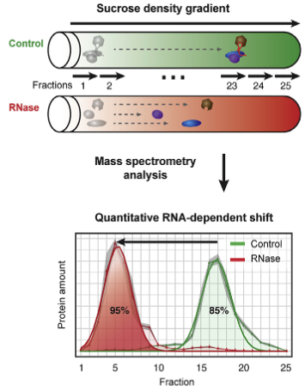
R-DeeP: Proteome-wide Screen for RNA-dependent Proteins
RNA-binding proteins (RBPs) play key regulatory roles in various central cellular processes: RNA biogenesis, regulation of gene expression, alternative splicing, …
malfunction of RBPs is origin of many diseases ranging from neurodegenerative disorders to cancer
R-DeeP : proteome-wide, unbiased, and enrichment-free screen, based on density gradient ultracentrifugation
defining a protein as RNA dependent when its interactome depends on RNA
RBPs are expected to migrate to different positions in a sucrose density gradient in the presence or absence of RNA

Slide 5
Dataset
25 fractions
3 repetitions
3680 human proteins
Human protein | Fraction 1 Rep. 1 Ctlr | Fraction 1 Rep. 1 RNase | Fraction 1 Rep. 2 Ctlr | Fraction 1 Rep. 2 RNase | Fraction 1 Rep. 3 Ctlr | Fraction 1 Rep. 3 RNase | Fraction 2 Rep. 1 Ctlr | … Fraction 25
PTPRJ_HUMAN | 0 | 0 | 0 | 0
B2L13_HUMAN | 76 | 88
Klasse 3 | 84 | 90

Slide 7
Layout "Titel und Inhalt" mit Diagramm

Slide 8
Folientitel hinzufügen – 1

Slide 10
Folientitel hinzufügen – 4

Slide 11
Folientitel hinzufügen – 5

